Slide 1

Fundamentals of Politics Research Lecture 4 (2020-21) A science of politics? Dr Adrian Blau

Slide 2
Last time
Deductions often go wrong, and things which sound like deductions may not be.
Induction’s a bitch and then you die. (Probably.)
Abduction is a key part of empirical and theoretical analysis.
We all make these mistakes; you should try to avoid them yourselves, and criticise them in others.

Slide 3
So what? Why this topic?
What we do matters more than what we call it.
But what we call it often affects what we do.
(False) images of science, especially textbook caricatures.
Look more to practice – social as well as natural science.
Controversial – often more than ideology!
Arrogance, imperialism, caricatures.

Slide 4
Structure of today
Start with naturalism, not science – helps us see politics as a whole, including normative political theory and normative political science.
Key scientific ideas: uncertainty, inference, etc.
Caricatures of science. (Don’t trust me either!)
Political theory, history of political thought.
Interpretivism, verstehen, constructivism.
Beyond science: naturalism and norms.

Slide 5
Naturalism
Not the primacy of natural science, but that philosophy and science are ‘continuous’ (Ritchie 2008, 195-6) – share the same assumption (right answers to empirical, conceptual and logical questions) and overlapping logic of inference.
Science (primarily empirical), analytical philosophy (primarily conceptual and logical).
Evaluation: both empirical and conceptual.
Compare Rehfeld (2010).

Slide 6
‘Data’, ‘evidence’, ‘facts’
‘Data’ aren’t given: abduce. We don’t need to accept gifts!
‘Evidence’ is always open to different interpretations: under-determination.
Facts vs. alleged facts: uncertainty.
King, Keohane & Verba (1994, 7-9):
‘The conclusions are uncertain.’
‘The goal is inference’: ‘the accumulation of facts alone is not sufficient.’

Slide 7
The real state of nature
Helmholtz (1852 lecture): we are not ‘capable of directly perceiving what the physicist approximates in a long chain of conclusions’:
‘attracting and repulsing molecular forces … no light, no color, no sound, no warmth’ (quoted in Schiemann 2009, 115).

Slide 8
Gadamer & theory-ladenness
‘the clear unambiguity of what has been seen with one’s own eyes’, ‘the certainty achieved by using scientific methods’ (2004, 212, 484).

Slide 9
Exercise 1: theory-ladenness
https://www.youtube.com/watch?v=Ahg6qcgoay4
https://bit.ly/30uwGYE

Slide 10
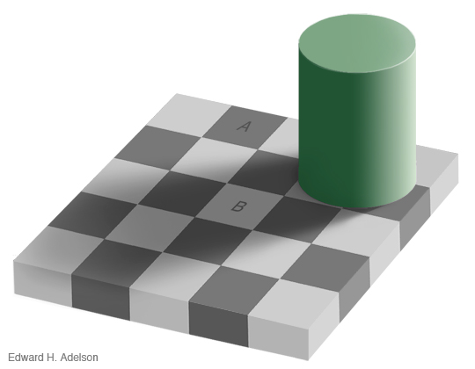
Theory-ladenness

Slide 11
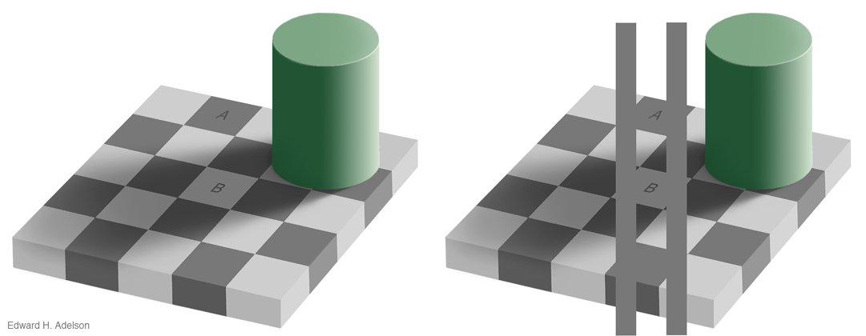

Slide 12
Gadamer & theory-ladenness
‘the clear unambiguity of what has been seen with one’s own eyes’, ‘the certainty achieved by using scientific methods’ (2004, 212, 484).
Theory-ladenness (Brewer and Lambert 2001).
If you’re interested: Nisbet (2003), Kahneman (2011).
Political/economic examples: e.g. Quattrone and Tversky (1988), Thaler and Sunstein (2009).
6SSPP385 Experimental Economics

Slide 13
Laws, prediction
Implied by Gadamer (2004, 3, 213, 229, 284).
Not even true for all natural science (Carnap 1966, 4-5) or Gadamer’s own father (Meyer and Imming 2011).
Most contemporary social science mentions neither laws nor prediction (e.g. KKV).
Even if (if) prediction is the best test of an explanation, it’s not central to most social science.

Slide 14
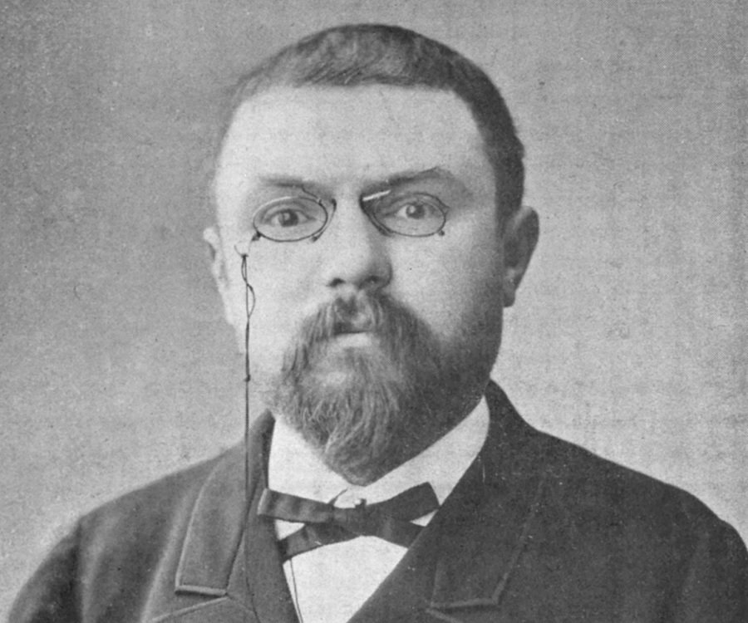
The logic of scientific inference
Gadamer equates ‘scientific rigor’ with ‘objectivity’ (2004, 329, 450; 2007, 114).
Henri Poincaré is this crude (1905, 140-2).
Controlled experiment: assess effect of one variable by trying to control other variables (Valieia 2001, 7-8, 11-14).
For more detail, see Moses & Knutsen (any edition), chapters 3-6, and 4SSPP103 CPS.

Slide 15
Testable (observable) implications
What would we expect to find if the claim is right? (And what would we expect not to find?)
What would we expect if the claim is wrong? (And what would we expect not to find?)
Example: winking and twitching (KKV pp. 36-41).
Example: policy change in France (Baumgartner et al. 2006).
Example: Strauss’s esoteric interpretations (Blau 2012, Blau 2015a).

Slide 16
Exercise 2
Using testable implications, think up an experiment to test the hypothesis that some people actually prefer to buy expensive items (e.g. clothing, watches) over cheaper items, because they like to own and/or be seen with expensive items. Note one limitation of the experiment.
N.B. Experiment is not just observation! Experiment is about a controlled comparison of groups with (ideally) one different variable.

Slide 17
Testing, not proving
Underdetermination, uncertainty and omitted variable bias are unavoidable; proof/disproof is impossible.
Don’t just look for evidence which fits your case.
The Birmingham Six (Rossmo 2005, 12-13).
Abduce: are the data reliable? What else could explain the (alleged) facts?
Think against yourself (Elster 2007, 20).
Think like detectives (Blau 2015b).

Slide 18
History of political thought
Empirical questions in HPT (about intentions and ‘intended meanings’) can be tackled scientifically (Blau 2015b).
For most statements in most texts, authors have some intended meaning(s) and some intention(s), which are more or less conscious and ambiguous (but never perfectly so).
i.e. we assume there are right answers here.
Compare Rehfeld (2010).

Slide 19
Normative political theory
Analytical political theory mostly assumes that there are right answers to conceptual and logical questions: naturalist but not scientific.
(Compare Rehfeld 2010.)
Absolute moral truths/laws???
E.g. Rawls (1971) aims not at truth but at coherence between moral judgements – ‘reflective equilibrium’ (topic 6).

Slide 20
Interpretivism/Verstehen
Dilthey: natural sciences aim at causal explanation by external analysis, human sciences aim at Verstehen – understanding meaning by reconstructing how people see/feel.
Understanding: explaining cause-effect or grasping mental states. See also Martin (1969, 53-6).
Verstehen is a kind of a descriptive inference (which can be part of an explanatory inference – Weber) and science isn’t only about explanation!

Slide 21
Verstehen and shared meanings
Weber, Schutz, Taylor: we need to understand the background of shared, intersubjective meanings – the ‘lifeworld’. Bevir (2003, 19).
Problem: researchers may be part of different lifeworlds! (See topic 8.)
Danger of studying politics anachronistically, ethnocentrically, androcentrically, etc.
See Yar (2005) on challenges to objectivity.
KKV (pp. 40-1) are weak on interpret’n/meaning.

Slide 22
Don’t forget methodology
Caulfield and Hill (2014, 18): ‘interpretivists challenge the idea of an objective reality that can be grasped through research. They are more concerned with people’s subjective understanding because they assert that the subject matter of the social world is completely different to that of the natural world.’
Misleading! And what is their methodology – their logic of inference?

Slide 23
Constructivism(s)
Kratochwil (2008, 81): are things ‘simply given and correctly perceived by our senses (empiricism)’, or are ‘the things we perceive the product of our conceptualizations (constructivism)’?
‘A second core belief of constructivists is that if we accept that the human world is one of artiﬁce, then the notions the actors have about their actions matter’ (p. 86).

Slide 24
Constructivism(s)
‘hard data are also constructions based on conceptual choices’ and ‘extreme care has to be taken not to treat them [data? conceptual choices?] as if they were natural facts’ (pp. 87-8).
He’s right about the conceptual basis of data, and simplistic analysis of ‘democracy’ etc. (88-94). But the problem is inadequate abduction about concepts, and being insufficiently philosophical.

Slide 25
Bevir and Rhodes (2004, 130-1)
‘to understand actions, practices and institutions, we need to grasp the relevant meanings, beliefs and preferences of the people involved. … Bentham asked “Is it true?” whereas Coleridge asked “What is the meaning of it?”. For Coleridge “the very fact that any doctrine had been believed by thoughtful men ... was part of the problem to be solved”. We ask, after Coleridge, “what is the meaning of it”, where “it” is British governance.’

Slide 26
Beyond science
Too many defenders and critics of science focus primarily on empirical questions and overlook normative ones.
Naturalism is a better place to start because it includes both.
This is why we make you study both political science and political theory!

Slide 27
Conclusions
Many people caricature the other side.
The logic of scientific inference is a powerful way of investigating claims.
There’s more to politics than ‘scientific’ explanation: Verstehen and meaning matter too.
There’s more to politics than empirical analysis alone: norms matter.

Slide 28
References not on the main reading list
Baumgartner, Frank, Martial Foucault, and Abel François. 2008. Punctuated equilibrium in French budgeting processes, Journal of European Public Policy 13:7, 1086-1103.
Bevir (2003) – see the Topic 5 reading list for Qualitative Methods 1:3 (2003).
Blau (2015a) – chapter in Reading Between The Lines, ed. Winfried Schroeder.
Blau (2015b) – ‘History of Political Thought as Detective-Work’ (here).
Carnap, Rudolph. 1966. Philosophical Foundations of Physics: An Introduction to the Philosophy of Science. New York: Basic Books.
Gadamer, Hans-Georg. 2004. Truth and Method. 2nd edition. London: Continuum.
Kahneman, Daniel. 2011. Thinking, Fast and Slow. London: Penguin.
Meyer, Achim, and Peter Imming. 2011. Benzylisoquinoline alkaloids from the Papaveraceae: the heritage of Johannes Gadamer (1867−1928), Journal of Natural Products 74:11, 2482-7.
Nisbett, Robert. 2003. The Geography of Thought: How Asians and Westerners Think Differently – and Why. London: Nicholas Brealey.
Poincaré, Henri. 1905. Science and Hypothesis. London: Walter Scott.

Slide 29
References not on the main reading list
Quattrone, George, and Amos Tversky. 1988. Contrasting rational and psychological analyses of political choice. American Political Science Review 82:3, 719-36.
Ritchie, Jack, 2008. Understanding Naturalism. Stocksfield: Acumen.
Rossmo, Kim, 2005. Criminal Investigative Failures. http://www.justice.gov.sk.ca/milgaard/pubdocs/04262006/Kim%20Rossmo/337674.pdf, accessed 30 October 2013.
Schiemann, Gregor. 2009. Hermann von Helmholtz’s Mechanism: The Loss of Certainty. A Study on the Transition from Classical to Modern Philosophy of Nature. Milton Keynes: Springer.
Thaler, Richard, and Cass Sunstein. 2008. Nudge: Improving Decisions About Health, Wealth, and Happiness. New Haven: Yale University Press.
Valiela, Ivan. 2001. Doing Science: Design, Analysis, and Communication of Scientific Research. Oxford: Oxford University Press.

